Slide 1
Digital Signatures
Cryptography and Data Security
Mihai TOGAN
mihai.togan@mta.ro

Slide 2
Agenda
About digital signatures
Signing with RSA
Signing with DSA

Slide 3
Security Mechanisms
Basic building blocks are used:
Encryption
used to provide confidentiality, can provide authentication and integrity protection
Hash/ checksums algorithms
used to provide integrity protection, can provide authentication (MACs, HMAC)
Electronic signatures (digital signatures)
used to provide authentication, integrity protection, and non-repudiation
One or more security mechanisms are combined to provide a security service

Slide 4
Electronic Signatures-based Mechanisms
Security objectives:
Data Integrity
Data Authentication
Origin Authentication
Data Non-repudiation
Origin Non-repudiation
Digital signatures provide the ability to:
verify author, date & time of signature
authenticate message contents
be verified by third parties to resolve disputes

Slide 5
Electronic Signatures-based Mechanisms
Algorithms: RSA, DSA, ECDSA (+SHA2, SHA3, etc.)
Combines a hash with a digital signature algorithm
Recommended Key Lengths for electronic signatures:
2048 bits key RSA
2048 bits key DSA
224, 256+ bits Elliptic Curves-based DSA (ECDSA)

Slide 6
Electronic Signatures Model
Signatures creation (generation)
Using signer-user’s private key
Signature verification (validation)
Using signer-user’s public key

Slide 7
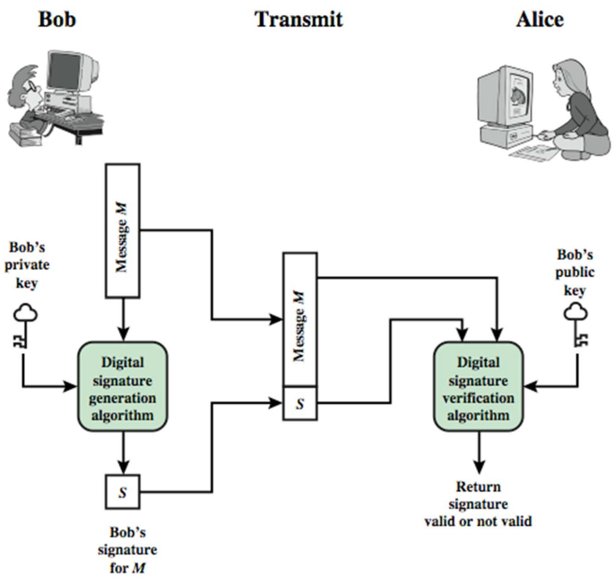
Electronic Signatures Model (cont.)

Slide 8
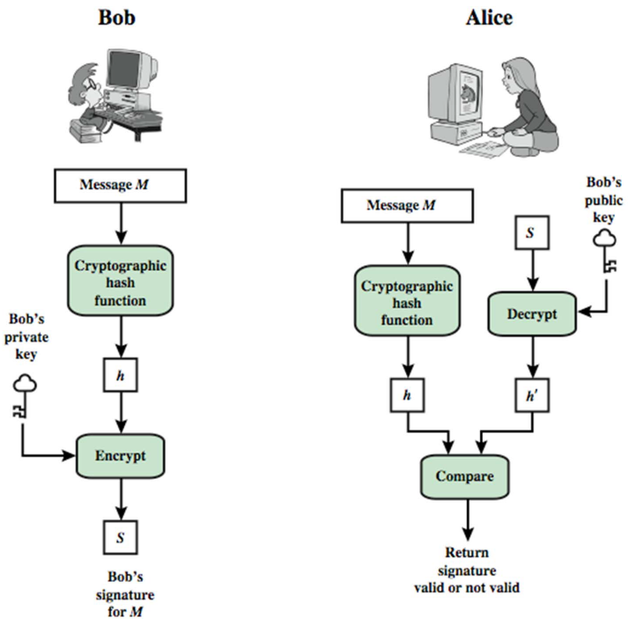
Electronic Signatures Model (cont.)

Slide 9
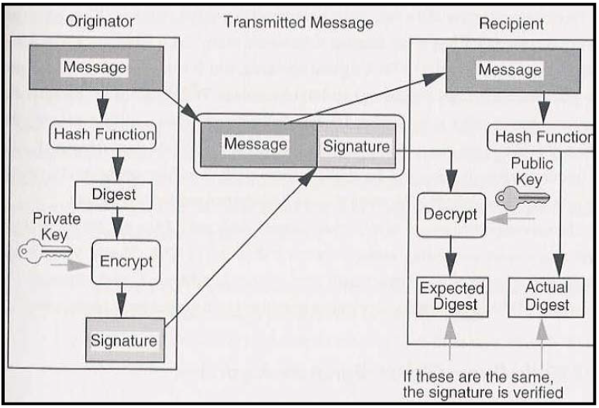
Electronic Signatures creating & verifying

Slide 10
Electronic Signatures Requirements
Must depend on the message to be signed
Must use information unique to signer (signer’s private key)
to prevent both forgery and denial
Must be relatively easy to produce
Must be relatively easy to recognize & verify
Must be computationally infeasible to forge
with new message for existing digital signature
with fraudulent digital signature for given message
Have to be practical to save digital signature in storage

Slide 11
Electronic Signatures
Involve only sender & receiver
Assumed receiver has sender’s public‐key
Digital signature made by sender signing entire message (or a hash of it) with sender’s private‐key
The signature can be encrypted using receiver’s public‐key (optional)
It’s important to sign first then encrypt message & signature
Security depends on sender’s private‐key

Slide 12
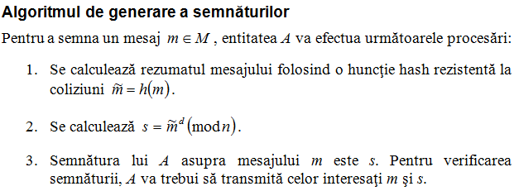
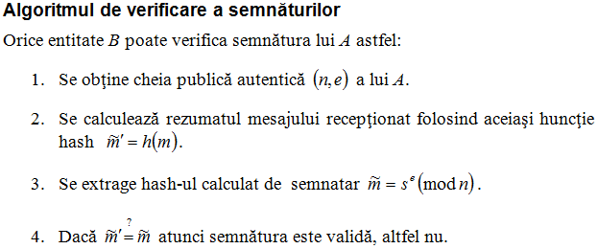
Digital Signatures using RSA
Algoritmul de generare a cheilor

Slide 13
Digital Signature Standard (DSS)
US Govt approved signature scheme
It’s a public‐key cryptography based technique
Designed by NIST & NSA in early 90's
Published as FIPS‐186 in 1991
Revised in 1993, 1996 & then 2000
Uses the SHA hash algorithm
DSS is the standard, DSA is the algorithm
FIPS 186‐2 (2000) includes alternative RSA & elliptic curve signature variants
DSA is digital signature only (unlike RSA)

Slide 14
Digital signatures using DSA
DSA = Digital Signature Algorithm
Algoritm propus de NIST in 1991, DSS = Digital Signature Standard (FIPS-186)
NU permite criptarea datelor
Securitatea: problema logaritmului discret (DLP) – problema grea:
DSA implica 3 algoritmi:
Algoritmul de generare de chei
Algoritmul de semnare
Algoritmul de verificare a semnaturii

Slide 15
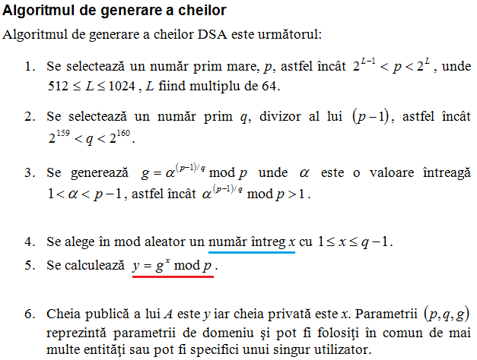
Digital signatures using DSA (contd.)

Slide 16
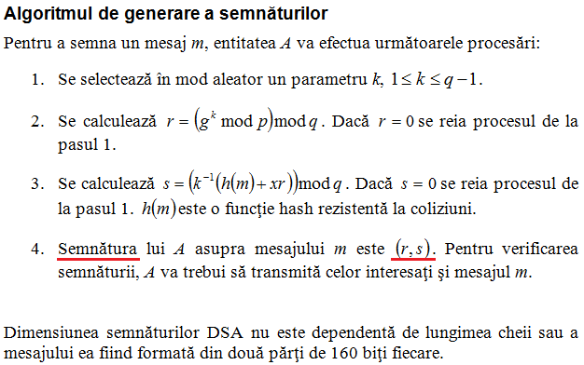
Digital Signatures using DSA (contd.)

Slide 17
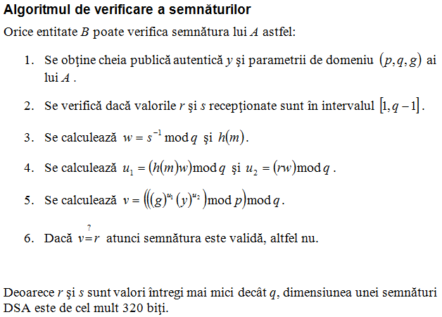
Digital Signatures using DSA (contd.)

Slide 18
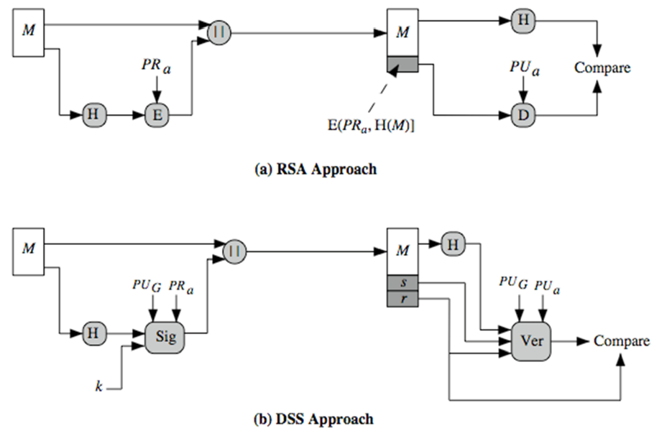
Schematics of RSA and DSA

Slide 19
Signature Algorithm types
Two digital algorithm types:
Digital signature with message recovery (ex. RSA)
Digital signature with appendix (ex. DSA)
Usually, sign a message digest (hash)
RSA is converted also to a digital signature with appendix

Slide 20
Public-Key Cryptography Standards (PKCS)
PKCS#1 – std. pt criptografia cu alg RSA
PKCS#2 – incorporat in #1 - criptarea digest –urilor criptografice
PKCS#3 – std. Diffie si Hellman Key Agreement
PKCS#4 – incorporat in #1 – formatul cheii RSA
PKCS#5 – std. pt criptografia bazata pe parole
PKCS#6 – std. pt sintaxa extinsa a unui certificat digital – extensii
PKCS#7 – std. pt formatul mesajului criptografic
PKCS#8 – std. pt sintaxa cheii private
PKCS#9 – std. pt tipurile de atribute
PKCS#10 – std. pt formatul cererii de certificat
PKCS#11 – std. pt API –urile criptografice ale dispozitivelor hardware
PKCS#12 – std. pt token-uri software
PKCS#13 – std. pt criptografia cu curbe eliptice – in dezvoltare
PKCS#14 – std. pt generatoarele de nr pseudoaleatoare – in dezvoltare
PKCS#15 – standard pt formatul informatiei pe token –urile criptografice

Slide 21
Electronic Signatures-based Authentication
Digital Signatures
Public Key Distribution (key-management aspects)
Certification Authorities (CAs)
Digital certificates (X.509)
PKI – Public Key Infrastructures
PKI components: CAs, RAs, Repositories, Users
Certificates validation process
Certificates path validation (be sure about the certificates authenticity)
Certificates status checking (revoked or not)
Certificate Revocation Lists (CRLs)
Builds (discover) and validates the certificate path
Other components
Time-stamping Authority, OCSP Authority , Signing Authority

Slide 22
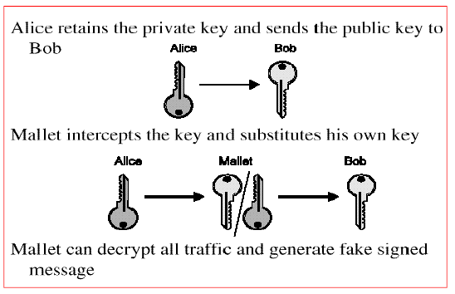
Public Key Distribution
The big problem: Man in the Middle !!!

Slide 23
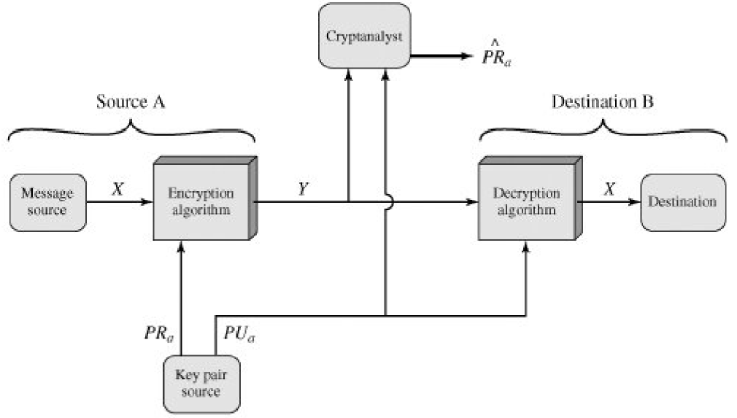
Generating fake signatures

Slide 24
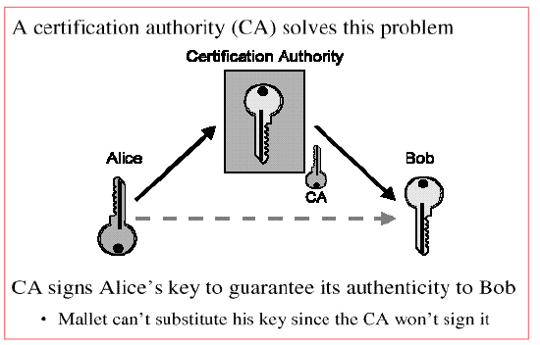
Public Key Distribution (contd.)
A trusted third party should authenticates the public key

Slide 25
Digital Certificate (contd.)
Is a person really who claim?
How do you know that the public key you got from a person (entity) really belongs to this person
Solution: CERTIFICATE – like an Information Highway Driver License

Slide 26
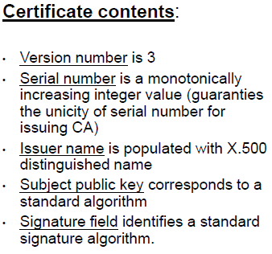
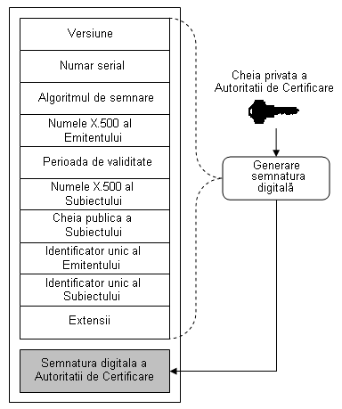
Digital Certificate X.509 v3

Slide 27
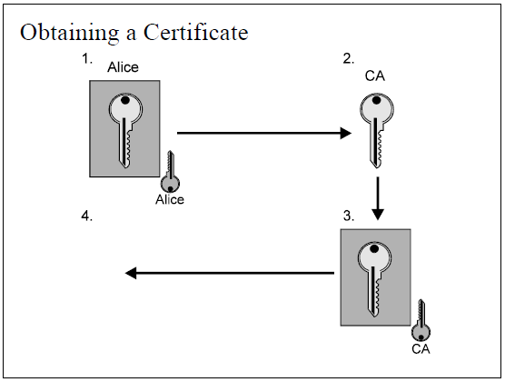
Digital Certificate X.509 v3

Slide 28
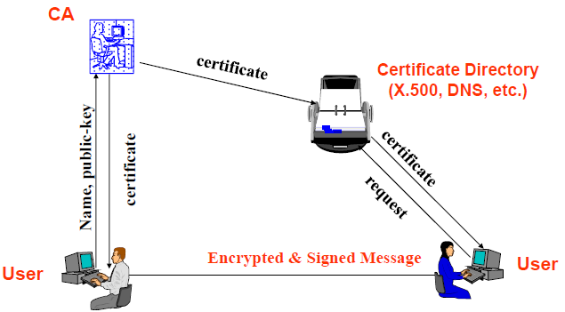
Workflows in PKI

Slide 29
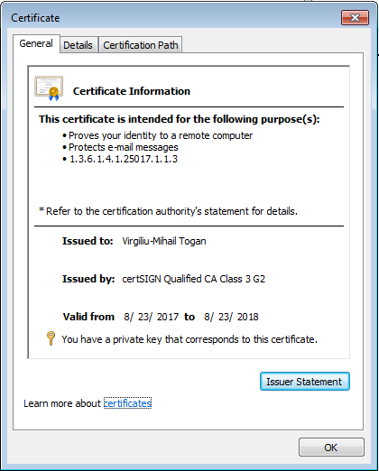
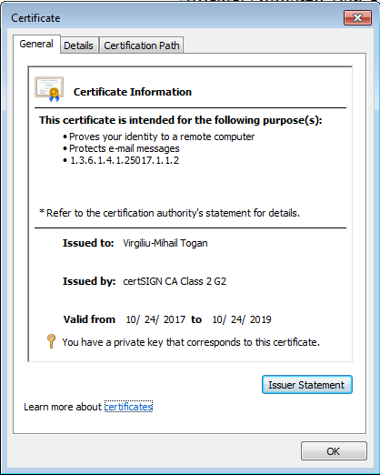
Examples of Digital Certificates X.509 v3
(using Windows built-in Certificate Viewer)

Slide 30
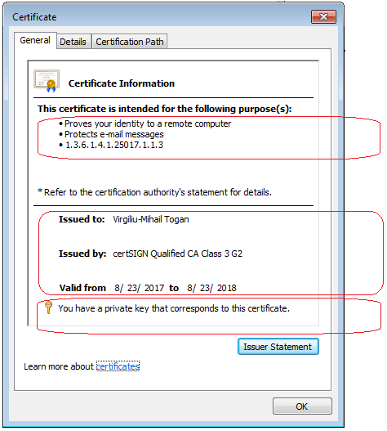
Example of Digital Certificates X.509 v3 (contd.)
(using Windows built-in Certificate Viewer)
There are several categories of information:
The main scope of certificate
The SUBJECT of certificate
The ISSUER of certificate
The validity of certificate
If there is a registered
private-key, pairing with this public key

Slide 31
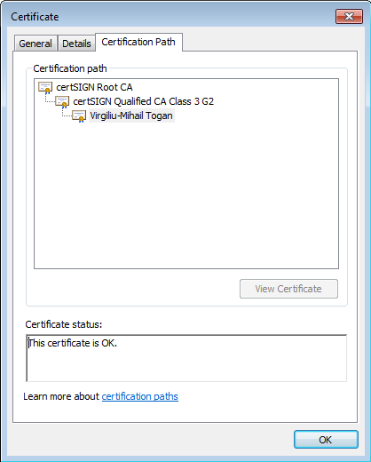
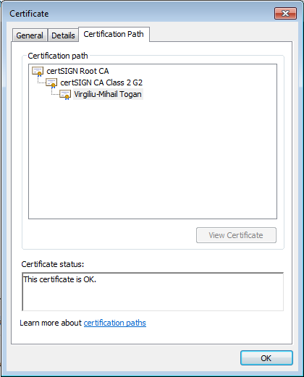
Certificate Chains
Each certificate has a certification-path starting from a ROOT-CA
Usually, Root-CA certificate is a trusted point in the system

Slide 32
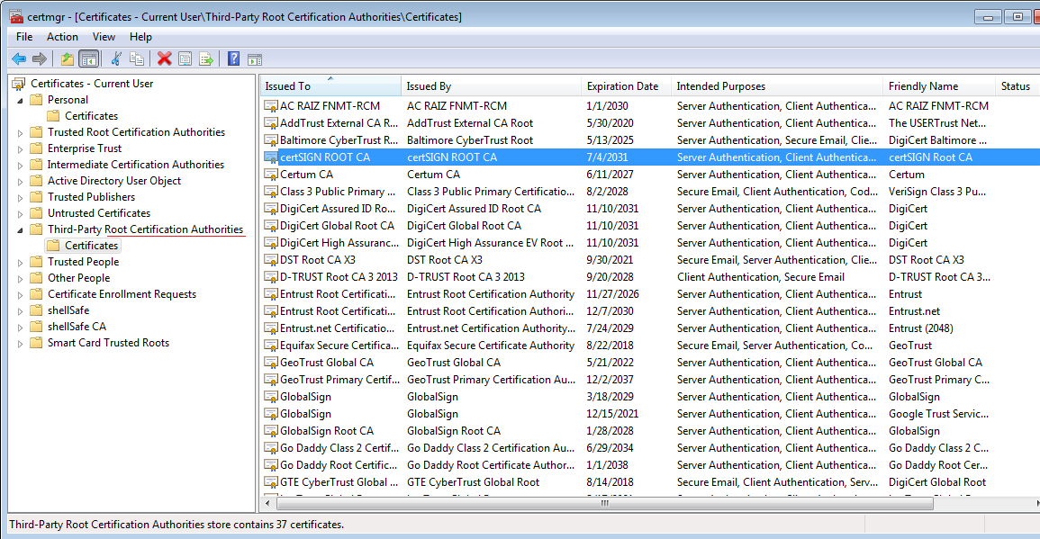
Digital Certificate X.509 v3 (contd.)
Trusted certificates (trust anchors) in Windows

Slide 33
Using certificates & PKI in real world
Document signing (ETSI, PKCS#7 formats)
Signatures with legal value
Email encryption & signing (S/MIME)
Transport-layer VPNs (using SSL)
Network-layer VPNs (using IPSec)
Web servers authentication (HTTPS)
Web servers & Client mutual authentication (HTTPS)
TCP servers & Clients authentication (SSL)
User authentication to services (databases, etc.)
Network/IT Infrastructure services access (smartcard logon)
…

Slide 34
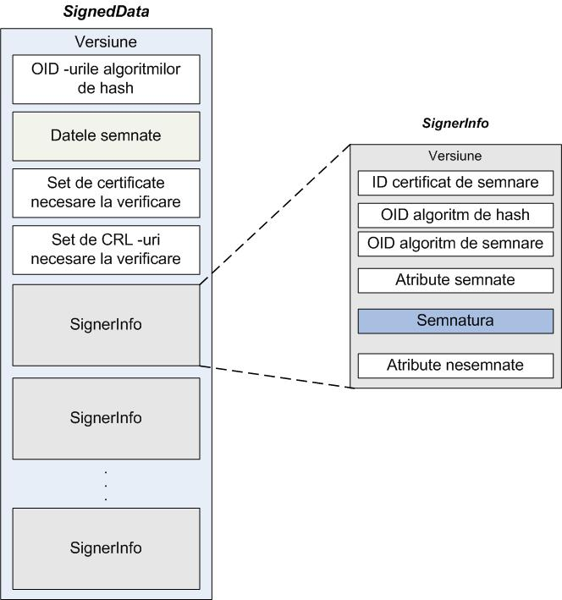
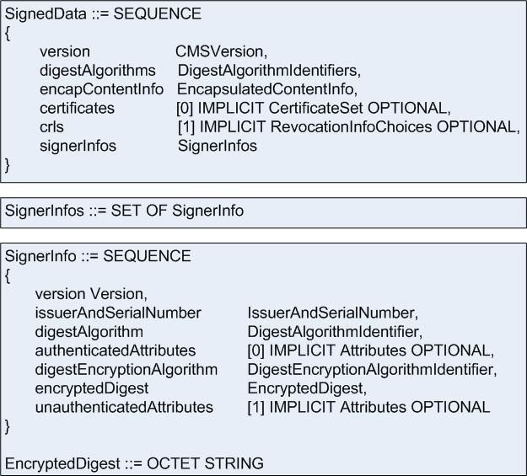
Document signing in real world
PKCS#7 signature format

Slide 35
Document signing in real world
Cadrul legislativ relevant
Directiva UE privind semnatura electronica (1999)
Legea semnaturii in RO (2001)
Legea marcii temporale in RO (2004, 2008)
Legea arhivarii electronice (2007)
Regulamentul UE eIDAS (2014 )

Slide 36
Public-Key Cryptography Standards (PKCS)
PKCS#1 – std. pt criptografia cu alg RSA
PKCS#2 – incorporat in #1 - criptarea digest –urilor criptografice
PKCS#3 – std. Diffie si Hellman Key Agreement
PKCS#4 – incorporat in #1 – formatul cheii RSA
PKCS#5 – std. pt criptografia bazata pe parole
PKCS#6 – std. pt sintaxa extinsa a unui certificat digital – extensii
PKCS#7 – std. pt formatul mesajului criptografic
PKCS#8 – std. pt sintaxa cheii private
PKCS#9 – std. pt tipurile de atribute
PKCS#10 – std. pt formatul cererii de certificat
PKCS#11 – std. pt API –urile criptografice ale dispozitivelor hardware
PKCS#12 – std. pt token-uri software
PKCS#13 – std. pt criptografia cu curbe eliptice – in dezvoltare
PKCS#14 – std. pt generatoarele de nr pseudoaleatoare – in dezvoltare
PKCS#15 – standard pt formatul informatiei pe token –urile criptografice

Slide 37

Cryptography
Bibliography:
D. R. Stinson,
Cryptography: Theory and Practice
B. Schneier,
APPLIED CRYPTOGRAPHY
W. Stallings,
Cryptography and Network Security

